Slide 1

Greater Toronto Hockey League
Player Registration Manual
2026-2027
As of April 22,2026

Slide 2
Contents
Section 1 – Player Registration Fee
Section 2 – Policies
Section 3 – Payment Process
Section 4 – Frequently Asked Questions (FAQs)

Slide 3
Section 1
Player Registration Fee

Slide 4
Player Registration Fee
The PRF fee can be paid in a one-time payment or in 5 installments.
There is a $50 administrative fee when selecting the installment plan.
There is a 2.9% credit card processing fee added to each credit card transaction, for both payments in full and installment payments. The processing fee is billed and paid directly to SportsPay, and will not reflect on the Hockey Canada invoice.
U10-U18 (A, AA & AAA) – Collection of payment is through the Hockey Canada online payment portal as either a one-time payment or six installments.
Installment plan – 1st payment upon registration (April/ May), 2nd June 20th, 3rd July 20th, 4th August 20th ,5th on September 20th.
Payment methods accepted are Visa, MasterCard, cheque or money order.
The League will accept post-dated cheques provided they are delivered to the League Office prior to the due date and dated for the above noted installment dates.
Should payment not be received as per the due dates, a financial hold will be placed on the player. All players must have the Player Registration Fee paid in full to begin programming by September 20, 2026.

Slide 5
Player Registration Fee
AAA
U10 – U18 – 33 Games
Cheque = $980.00
+ 2.9% credit card processing fee = 1008.42
Installment plan is subject to fees noted above plus $50.00
AA/ A
U10 – U18 – 34 Games
Cheque = $980.00
+ 2.9% credit card processing fee = $1008.42
Installment plan is subject to fees noted above plus $50.00

Slide 6
Player Registration Fee
Each APPROVED Team Official who is a parent or legal guardian on the same approved roster for A, AA and AAA associations, is eligible for a $100 rebate towards the Player Registration Fee.
Application process to be announced.
NOT ELIGIBLE:
One parent or legal guardian is a head coach, assistant coach, trainer or manager on a different approved roster than his/ her child, the player is NOT eligible to receive the $100 rebate.
The head coach, assistant coach, trainer or manager is a parent or legal guardian to a child other than yours, the player is NOT eligible to receive the $100 rebate.
The head coach, assistant coach, trainer or manager is the parent or legal guardian to two children and is part of the bench staff on two rosters, is NOT eligible two $100 rebates.
No sibling rebates for multi-player families.
ELIGIBLE
One parent or legal guardian is an approved head coach, assistant coach, trainer or manager on the same approved roster as his/ her child. The player registered is eligible to receive $100 off the Player Registration Fee.
The second parent or second legal guardian is an approved head coach, assistant coach, trainer or manager on the same approved roster as his/ her second child. The second player registered is eligible to receive $100 off the Player Registration Fee.

Slide 7
Section 2
Policies

Slide 8
Policies
All players require a completed PRF Registration with full payment submitted by September 20, 2026 as a condition of approval.
A Player who has not paid the PRF 5 days after an outstanding payment notification has been issued regarding an installment payment, will become ineligible to participate.
A Player who suffers a season-starting or season-ending injury/ illness/ condition/ mental-health barrier would be refunded on a pro-rated basis after the submission of a medical report indicating such, and a full review by the GTHL office. Refunds are at the discretion of the GTHL.
A Player who suffers a short-term injury (they would be returning to play at some point during the season) is not eligible for a refund.
A Player who is suspended is not eligible for any refund.
A Player who is released from a team and does not re-sign with a GTHL Club prior to January 15, 2026 will be eligible for a pro-rated refund which will be issued after January 15, 2026.

Slide 9
Policies
A Player who registers after the start of the regular season will have the Player Registration Fee reviewed for a pro-rated refund of games missed in the regular season.
A Team Official rebate is only to be offered to a player whose parent or legal guardian is a Team Official on their roster and is registered and not released prior to/including December 15.
A parent or legal guardian Team Official who is released prior to or on December 15 voids that player’s eligibility for the rebate.
No more than one rebate can be applied per player.
NSF returned cheque fee is $25.00
If during the installment period the players’ profile becomes delinquent at any point, all rebates could become void.

Slide 10
Policies
All refund requests will be processed beginning January 1, 2027. Exceptions to the January 1, 2027 date may be made on payments submitted in error or as duplicates.
A request for a refund will only be considered if such request is submitted to the GTHL Office on or before April 15 of current playing season (e.g. for the 2026-27 season, the deadline is April 15, 2027).
No refund requests for past seasons will be considered.

Slide 11
Section 3
Payment Process

Slide 12
Payment Process
The GTHL PRF will be open for registration on Saturday April 18, 2026. You can find the link to register on the GTHL website here:
www.GTHLCanada.com/player-registration-fee
The following slides will assist you in this process.

Slide 13
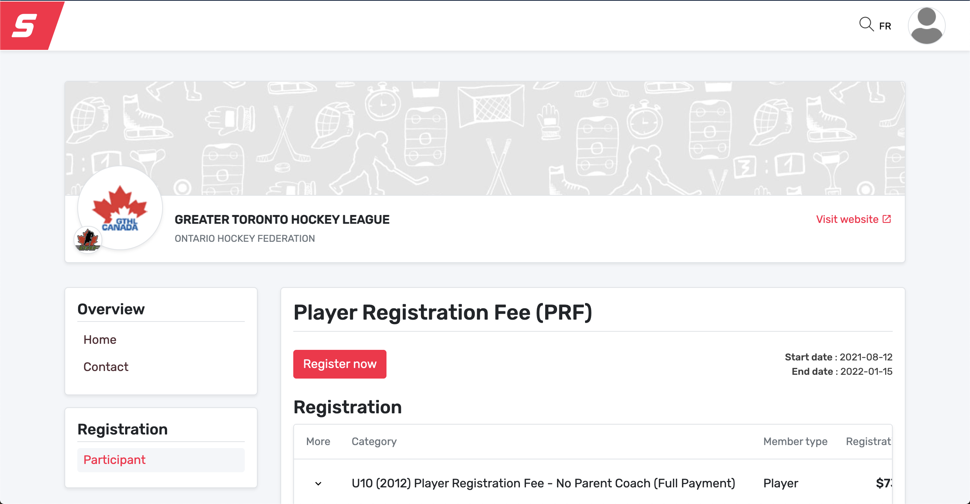
Payment Process
The registration link is available on the GTHL website under Players & Parents > Player Registration Fee. If you haven’t set up your new account in Hockey Canada, you must do that first at https://account.spordle.com/

Slide 14
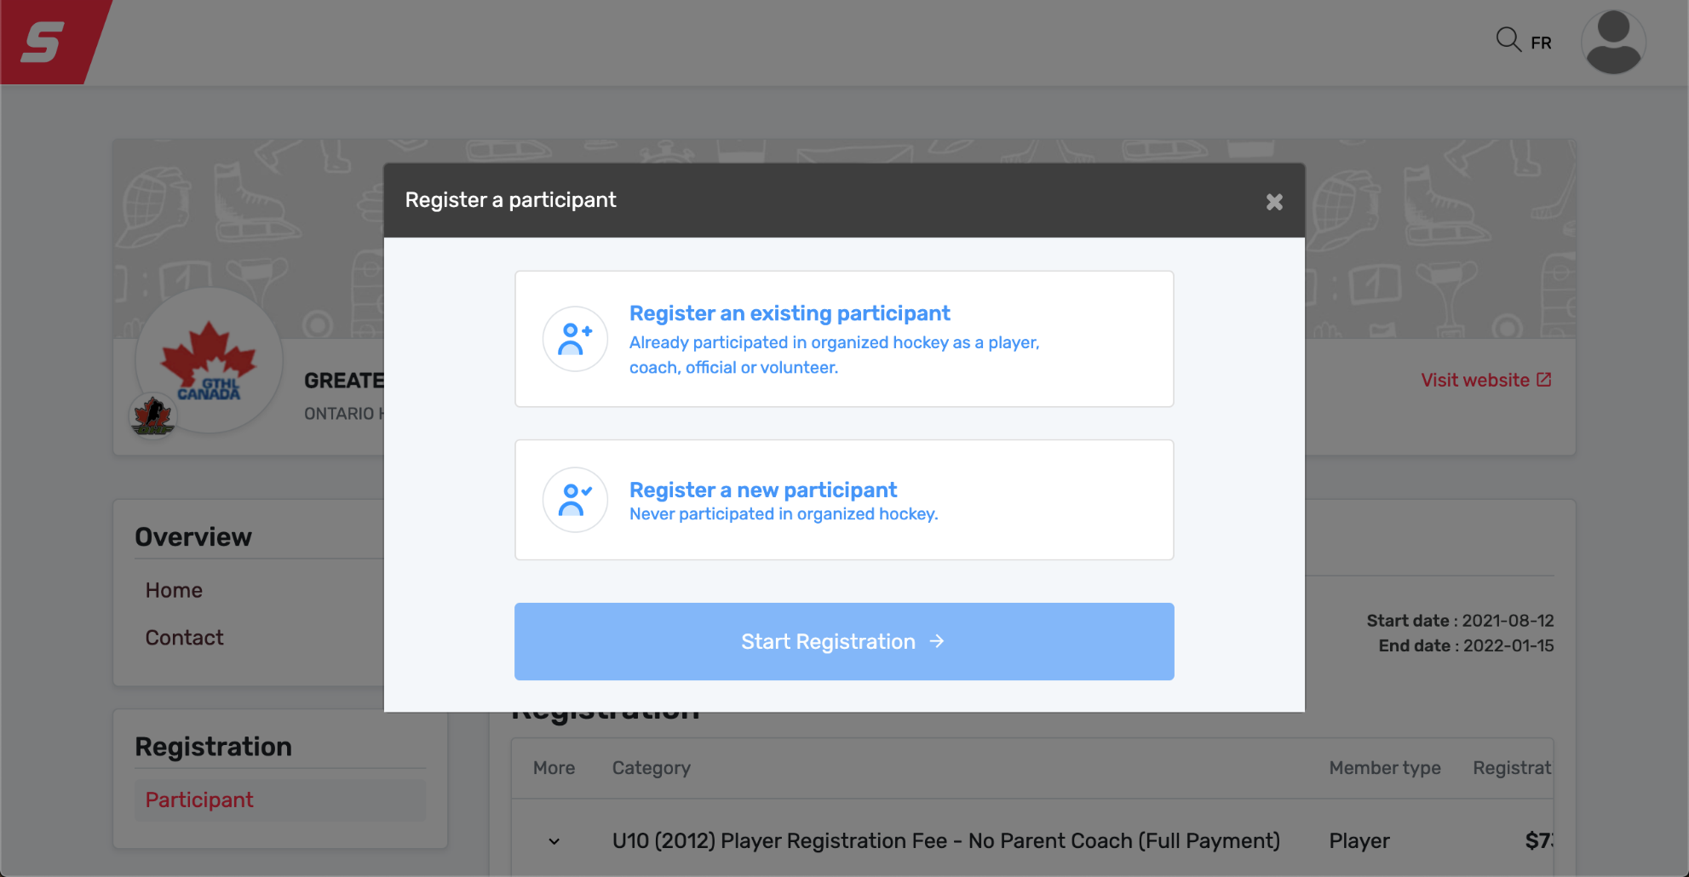
Payment Process
Select existing participant to continue. If you haven’t registered your participant, select register a participant.

Slide 15
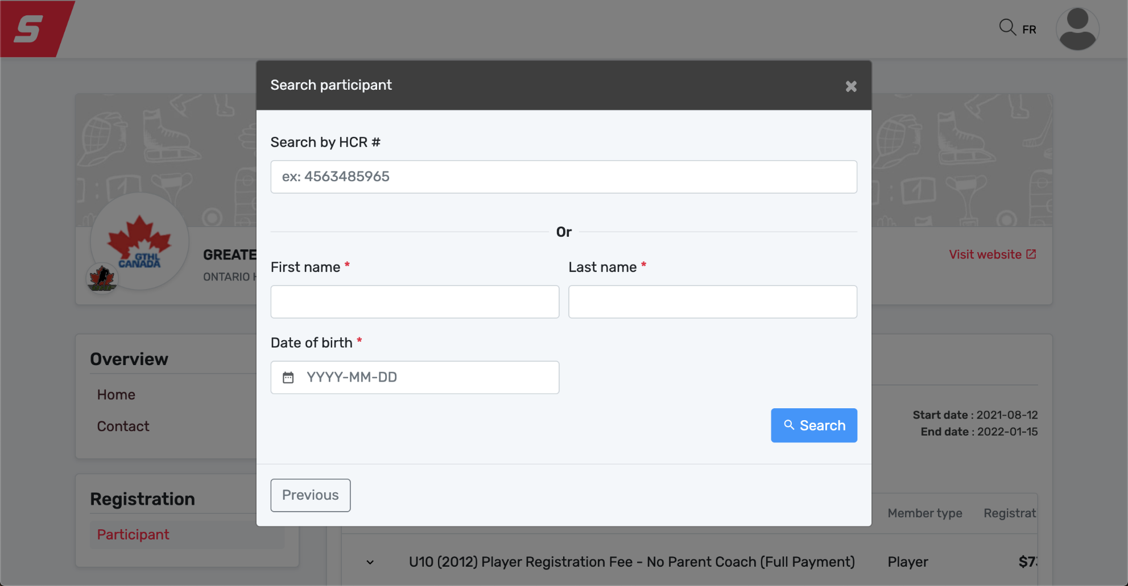
Payment Process
Choose to search your player by their HCR # or first and last name and date of birth and click search.

Slide 16
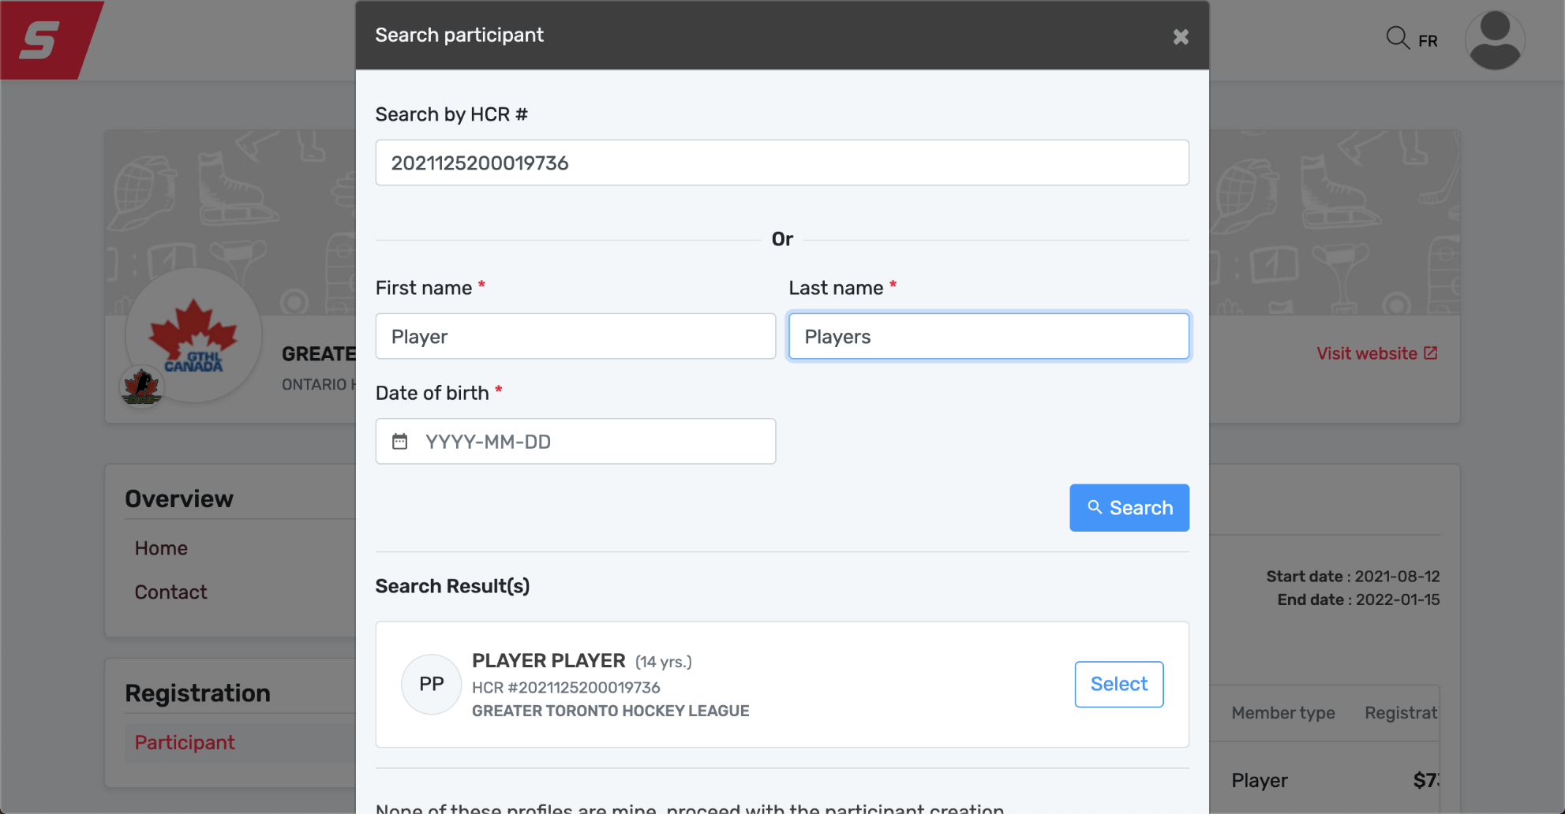
Payment Process
Once your player’s name is found, a box will pop up with the confirmed information, click select. If your player doesn’t show up, please make sure all information is correct.

Slide 17
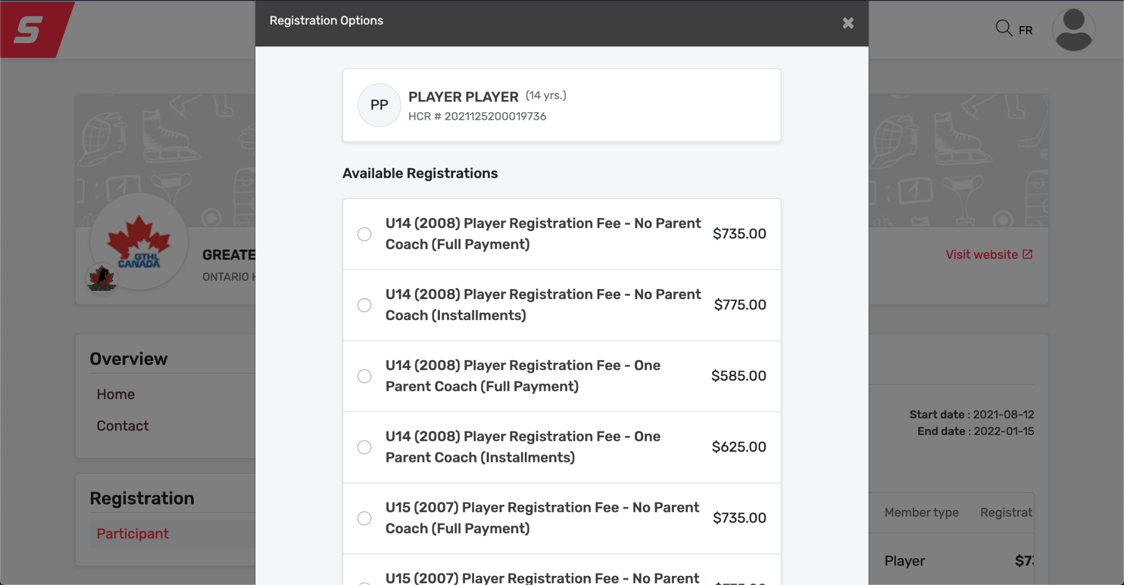
Payment Process
The player’s date of birth will populate the options by year of birth. Choose the plan that matches your YEAR of BIRTH, and select full payment or installments, according to your preference. Note; all discounted packages that are selected will be confirmed by our Office.

Slide 18
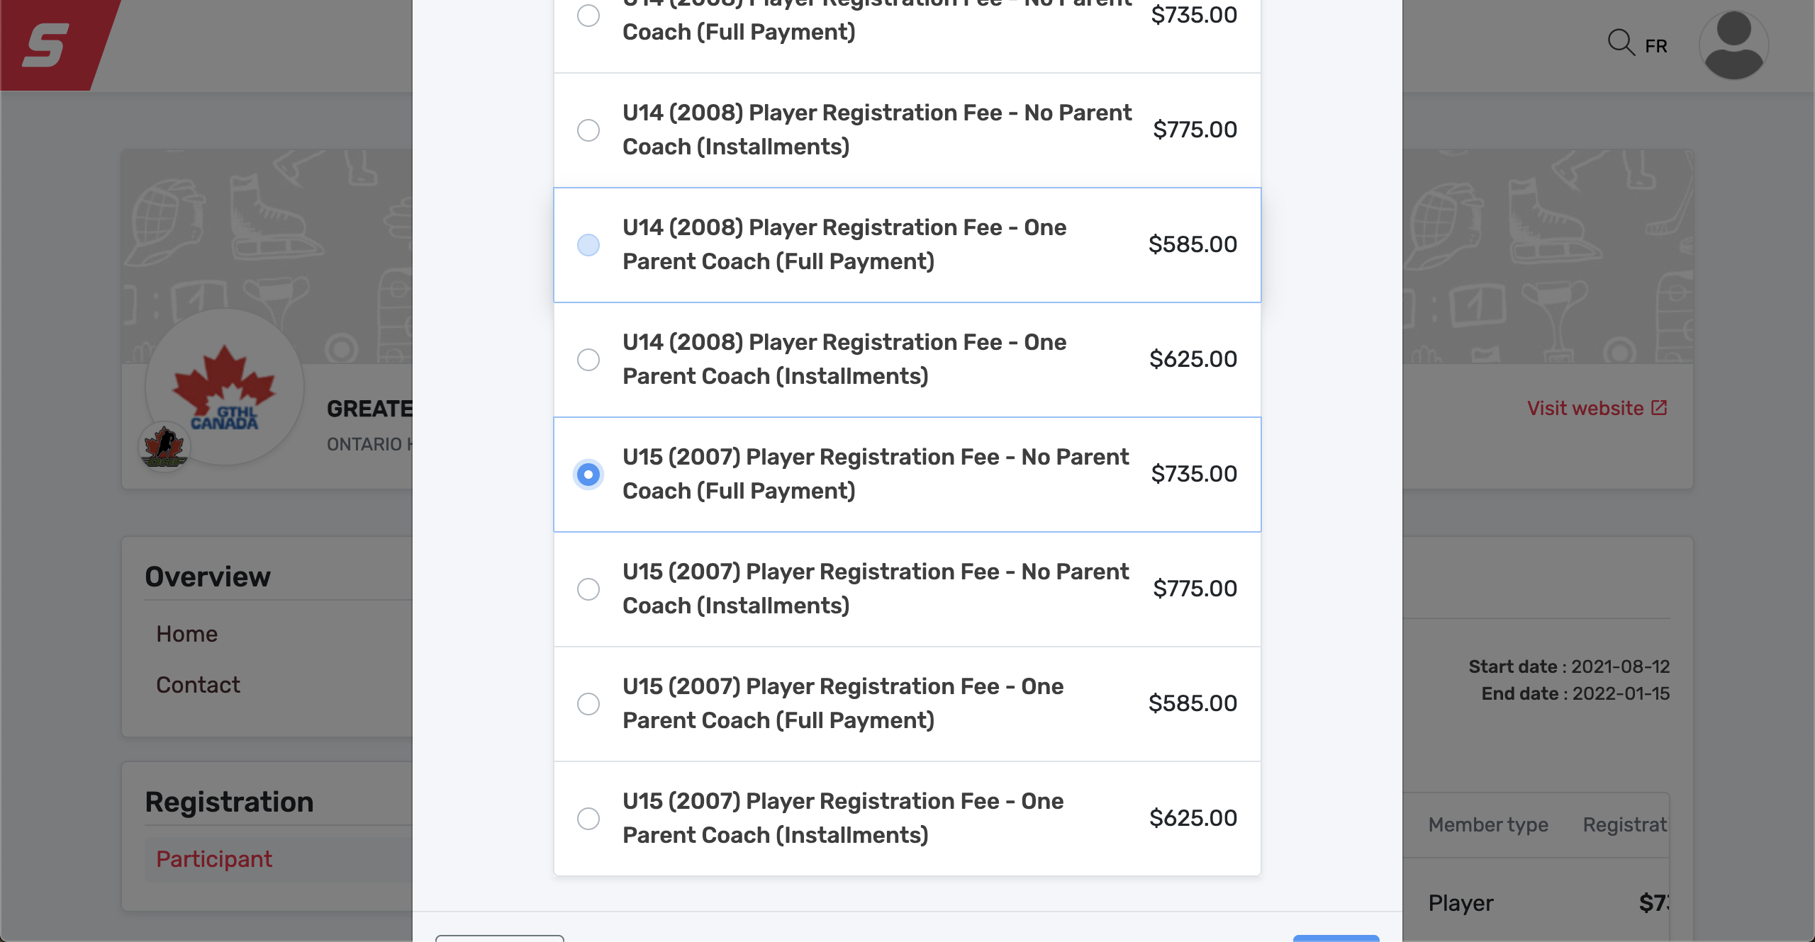
Payment Process
Once you choose your package, you will click the circle and click next.

Slide 19
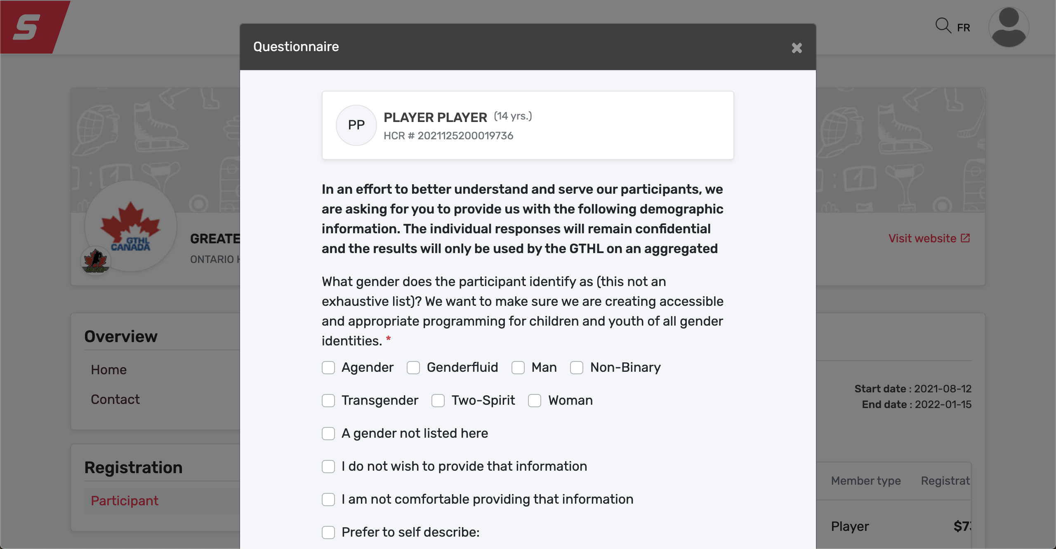
Payment Process
Completing the questionnaire will be required to move forward.
Please select all options that pertain to you. Click next.

Slide 20
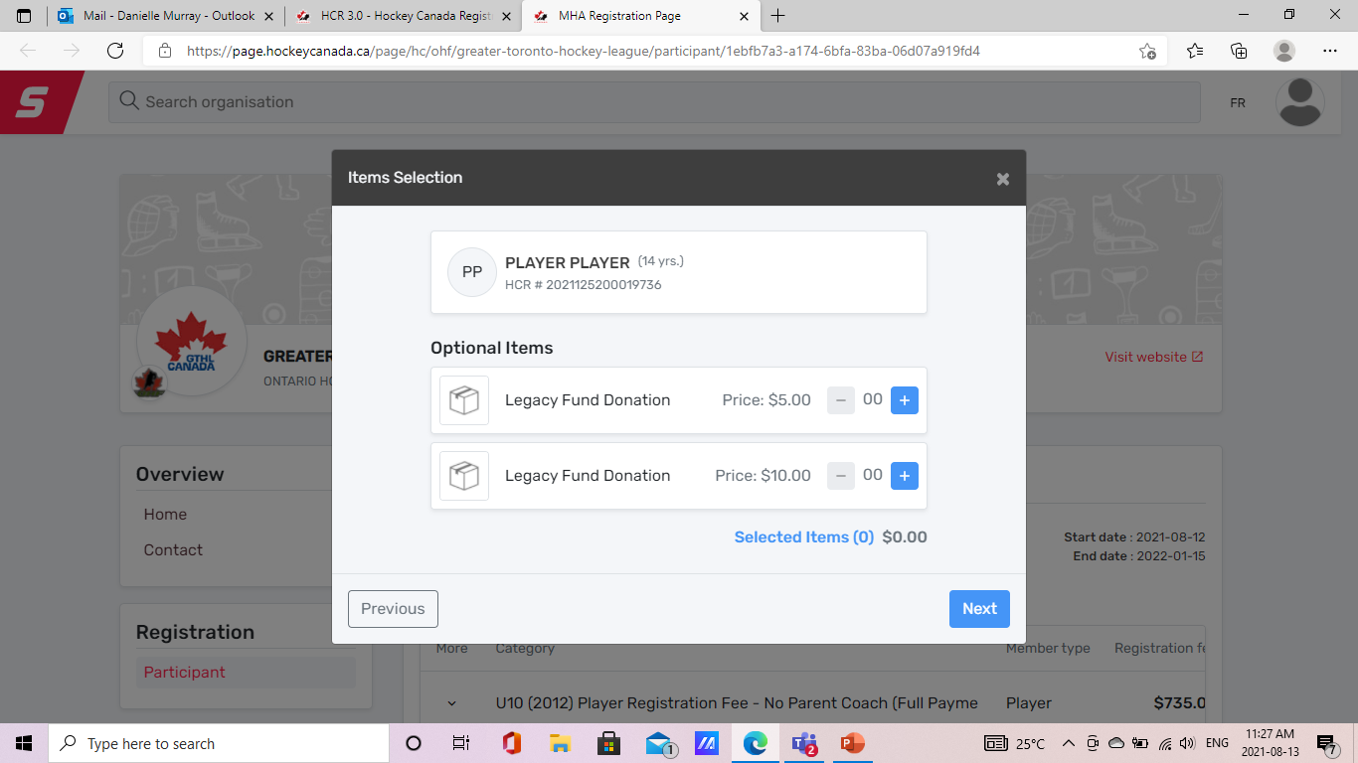
Payment Process
The Greater Toronto Hockey League (GTHL) launched the Legacy Fund as part of it’s 100th Anniversary Celebration in 2011. The Fund is used to assist individual players with the financial expenses involved in accessing hockey programs. The Fund also provides seed money to organizations that develop programs aimed at providing hockey opportunities to players and families who may not otherwise try the game of hockey.
To learn more visit Grants & Funding For Players – GTHL (gthlcanada.com)
This year with the GTHL Player Registration Fee you will have the option to donate $5, $10 to the GTHL Legacy Fund. If you would like to contributed a larger amount and receive a tax receipt you can make your donation directly through the Toronto Foundation GTHL Legacy Fund - Toronto Foundation
We thank you for any an all support you may be able to provide.

Slide 21
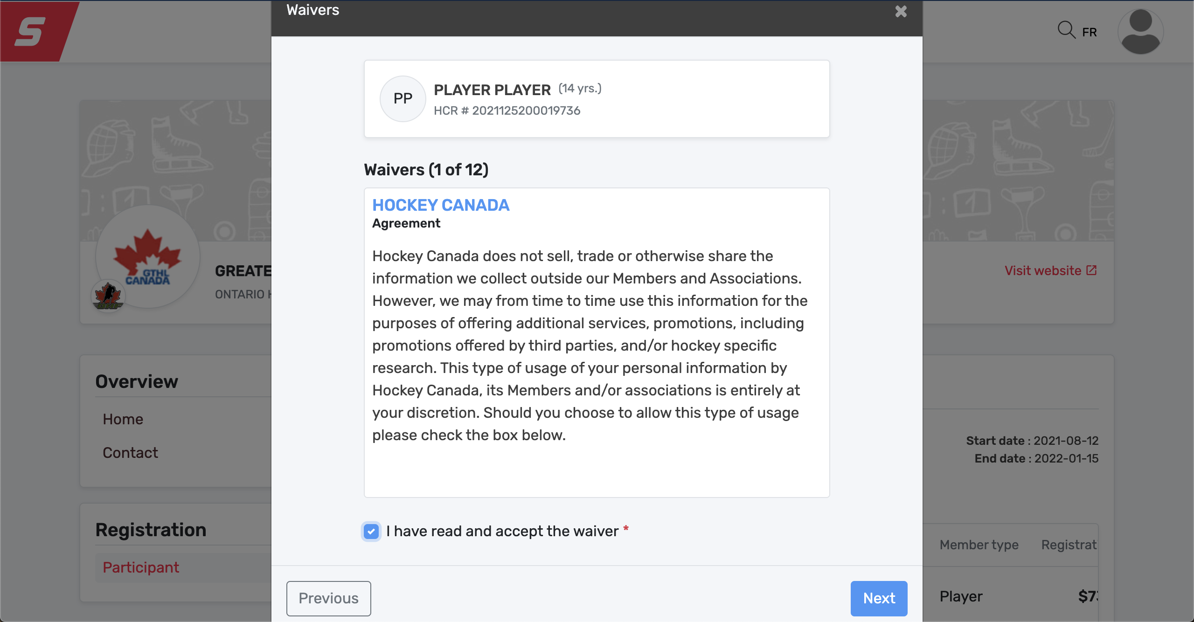
Payment Process
All Waivers will fall in order, you must sign off on each waiver to move forward. Click next.

Slide 22
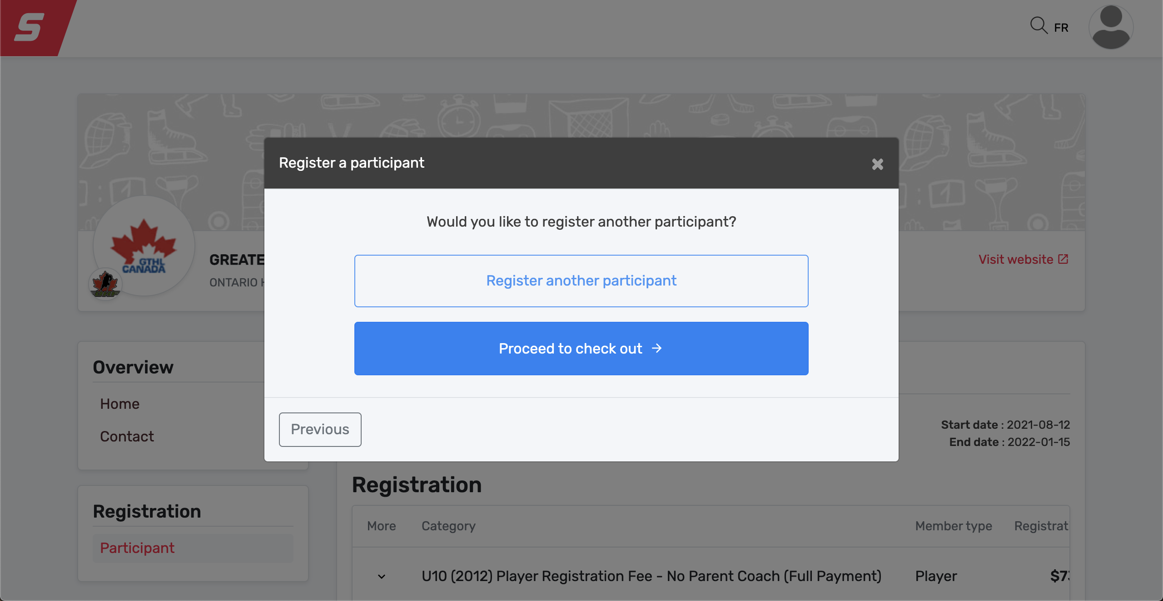
Payment Process
At this point, you will have the opportunity to Register another participant, or proceed to check out.

Slide 23
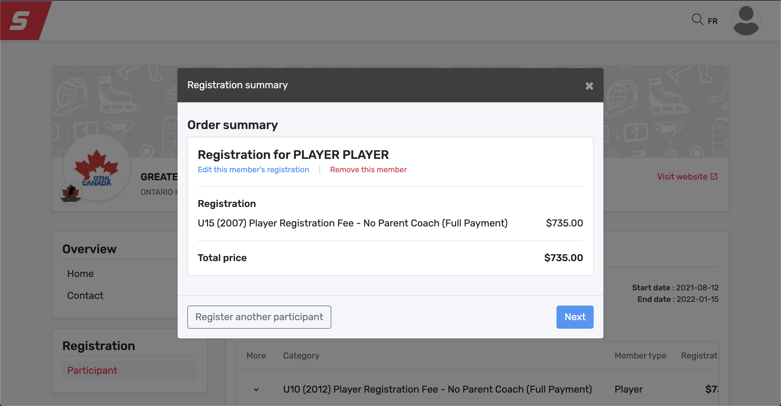
Payment Process
This page offers a summary of your registration. Please review and ensure everything is correct. You can also register a sibling at this point, by selecting register another participant, or select next.

Slide 24
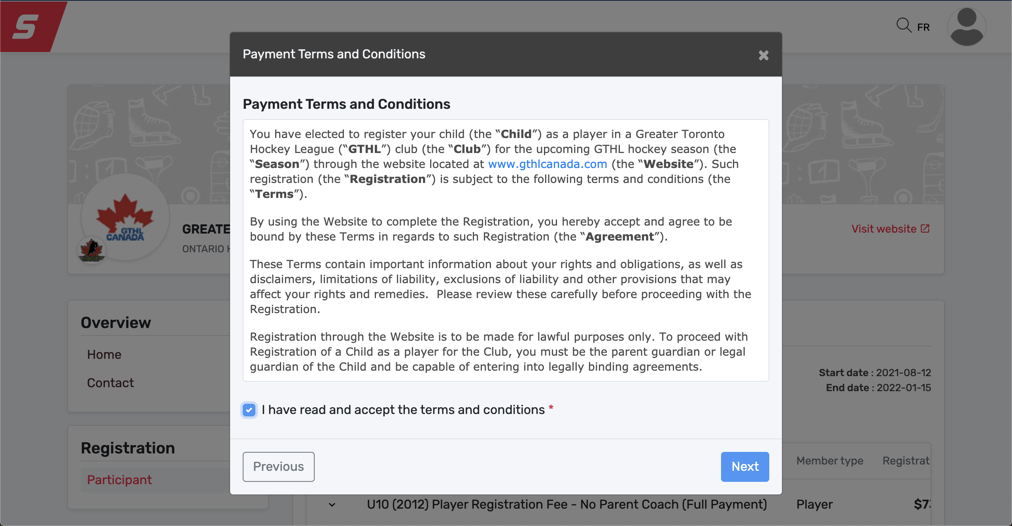
Payment Process
Please Review the Terms and Conditions, and sign off. Click NEXT

Slide 25
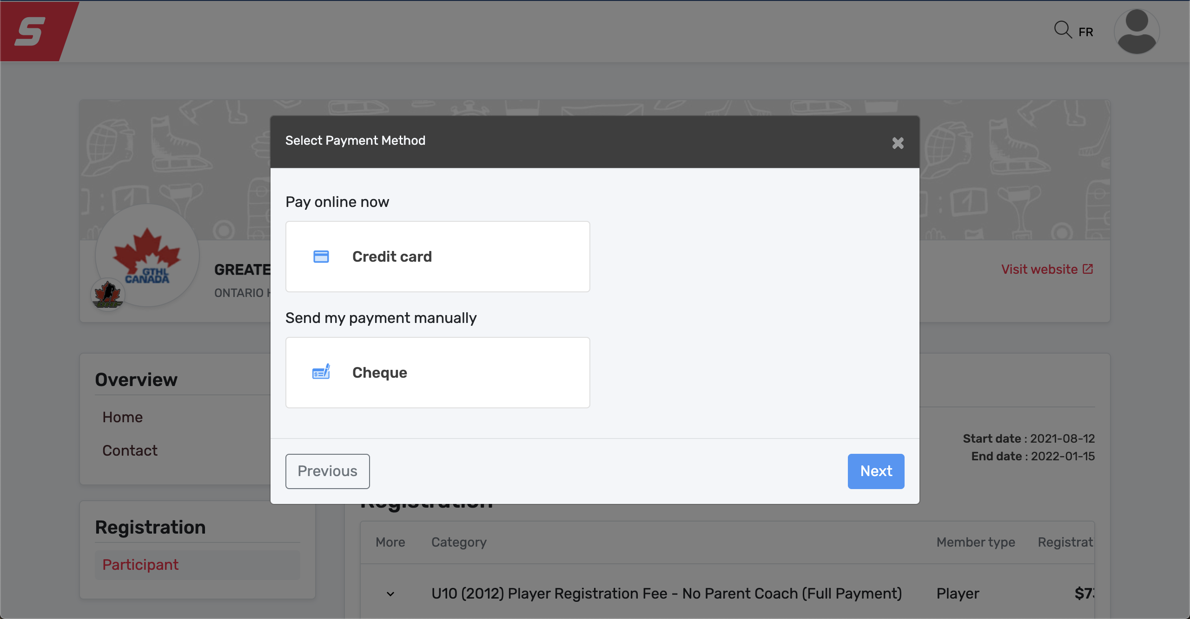
Payment Process
To pay online through credit card, select Credit Card. To pay through post dated Cheques, please select Cheque. Click Next. Cheques must be received immediately at the GTHL Office.
57 Carl Hall Rd, Toronto, ON M3K 2E2. In MEMO of cheques, please include Player Name and HCR #.

Slide 26
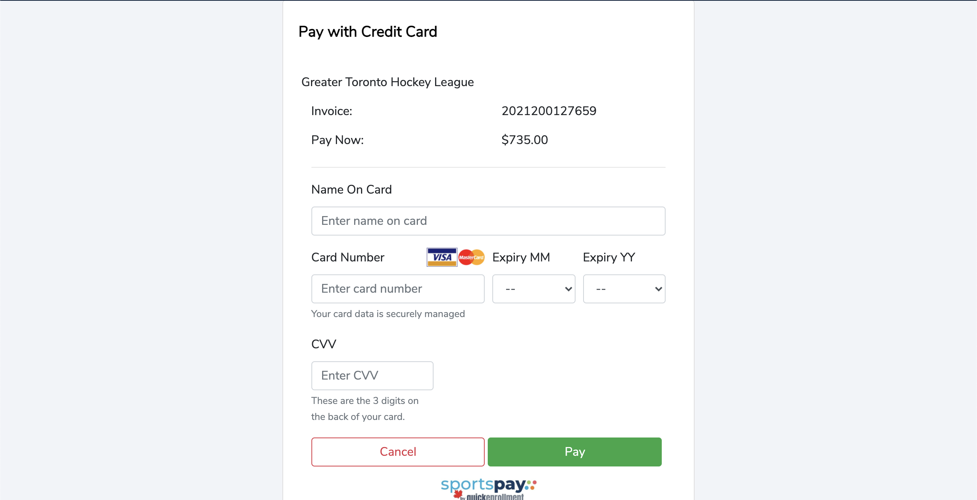
Payment Process
If Credit Card payment is selected, complete the payment page and click Pay.

Slide 27
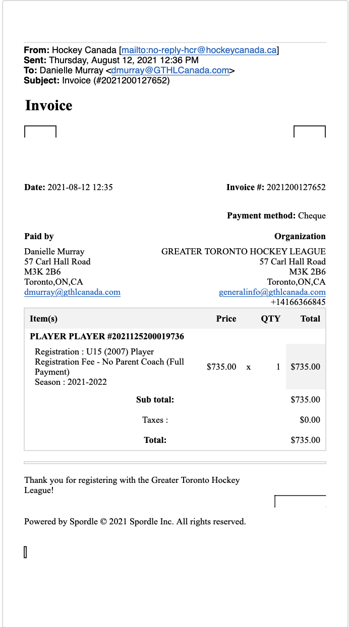
Payment Process
Whether you select Credit Card payment or Cheque, the system will generate and email an Invoice as shown below. Keep this for your records.

Slide 28
Section 4
Frequently Asked Questions (FAQ)

Slide 29
FAQs
1) How do I know if a player is eligible to participate in a game?
A: The player will appear with an APPROVED status on the roster. This can be discussed with the
club your player is registered with.
2) When a player registers late (for example, in December) is the player allowed to play immediately and/or is there a grace period to clear the payment process?
A: The player will remain ineligible on the roster until the family completes the Player Registration
Fee. Once completed, the club where you are registered can submit the roster for review of
the newly added player. Once payment is confirmed the player will appear APPROVED
on the roster.
3) Will the Hockey Canada online registration system accept both Credit and Debit cards?
A: Hockey Canada Registry will accept Visa, and MasterCard. The League Office will
accept post dated Cheques. Debit cards are not accepted.

Slide 30
FAQs
4) Can I pay by cheque and how?
A: The Hockey Canada online registration will allow you to “check-out” by cheque. The cheque(s)
must be forwarded along with the order receipt to the GTHL office. Cheques should
be made out to the Greater Toronto Hockey League and include the correct deposit dates along
with the players’ name and HCR number in memo section.
Please forward all cheques immediately following registration.
Outstanding payments may result in the player being placed on a financial hold.
Inquiries about cheque payments should be forwarded to Danielle Murray, Manager, Registration at
dmurray@gthlcanada.com
Cheques should be sent to the below address or dropped off at the Greater Toronto Hockey League office:
Greater Toronto Hockey League
57 Carl Hall Rd.
Toronto, Ontario
M3K 2B6

Slide 31
FAQs
5) How is a player informed that playing privileges have been removed? Is the Club and Team informed as well?
A: The League office will notify the club President and/ or the General Manager. The club executive
will be responsible for notifying the Head Coach of the team, and the family. Failure to do so will
result in an ineligible player on the game sheet.
6) What happens if a team plays an ineligible player?
A: – If a player participates while ineligible, League Rules governing participation of an ineligible
player will be imposed. This provision is covered in GTHL Regulation 14.4
http://www.gthlcanada.com/page/rulebook#suspensions
7) Will families who are entitled to the bench staff rebate have to pay the full Player Registration Fee upfront?
A: Yes, the full PRF is due at the time of registration. Rebates to follow later in the season.

Slide 32
FAQs
8) How are injuries defined for the purpose of determining if a player is entitled to a refund when injured?
A: A note from a Medical Doctor would be required. ONLY season-ending injuries or season-starting
injuries will be eligible and considered for refund, after a review by the league office.
9) If a payment date is missed, what are the consequences?
A: A player has 5 days after notification of an unsuccessful installment transaction to make a
payment for the amount owing. After 5 days, the full payment of the fee will be due and the player
will be ineligible to participate until such time as payment is made. Furthermore, if the payment is not
made within the 5 days, any discounts that were applied may become void.
10) Can a player receive more than one discount?
A: No, each player is only entitled to one bench staff rebate if they have a parent or legal guardian on
their roster in an APPROVED status as a Head Coach, Assistant Coach or Trainer.

Slide 33
FAQs
11) What happens if one parent or legal guardian coach is with one sibling’s team and the other parent or legal guardian is with the other sibling’s team?
A: Each player on each separate roster will receive the $100 rebate for having an APPROVED parent or legal guardian on the same roster as the child.
12) What happens if I select the wrong PRF package from my options?
A: Please email Danielle Murray, Manager, Registration at dmurray@gthlcanada.com to have the situation reviewed.
13) What happens if the GTHL season is cancelled due to Public Health direction due to pandemic conditions related to Covid-19? Is there a refund?
A: In the event as the result of a decision made by the local public health agency or a decision by the Federal, Provincial and/or Municipal government, each player affected by such decision will be refunded a portion of the Players Registration Fee on a pro-rated bases.
14) I can’t register because it says my player is registered to another organization outside the GTHL.
A: The player may require a transfer from their primary organization. Please speak to the hockey club you are looking to register with.

